Slide 1

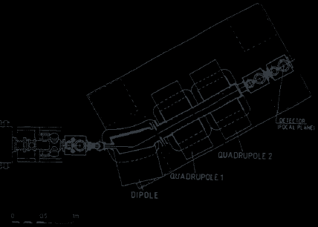
Institute of Modern Physics
Chinese Academy of Sciences
LEARNING GROUP
Velocity Filters
for heavy-ion fusion products
Zhiheng Hu
29 Sep 2026 · Exp. Techniques NP Ch. 11
Notes:
Welcome to the learning group. Today we cover velocity filters from Chapter 11. I will show you why a filter that ignores mass is the most sensitive way to find superheavy elements.

Slide 2
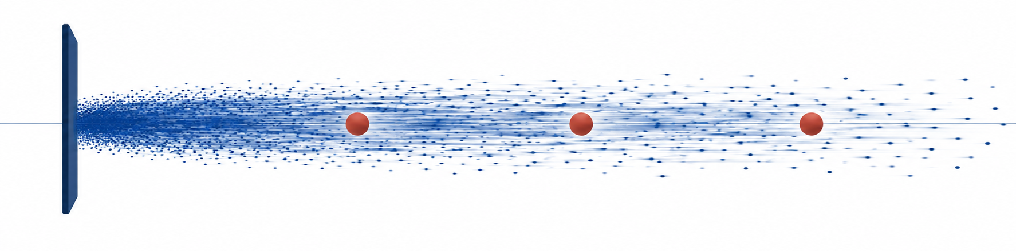
Ten days of beam produced three atoms of ₁₀₈Hassium.
Fusion residues leave the target in the beam direction, inside the unreacted beam.
Target: ²⁰⁸Pb
Residue: ²⁶⁵108
Ejectile: n
Projectile: ⁵⁸Fe
SHIP (GSI): iron beam on a lead target for 240 h (Ch. 11, Fig. 14) · Illustration: blue = beam, red = fusion residues
Learning Group
Background
Notes:
At GSI, SHIP ran an iron beam on a lead target for ten days: 6 × 10¹⁷ projectiles. Three atoms of element 108 came out — flying in the same direction as the beam. How would you pick those three out? That is the job of a separator, and today's device does it by velocity.

Slide 3
Outline
1. Why not just use a mass spectrometer?
2. How does a filter survive the beam?
3. Without mass, how do we know what we caught?
4. When is a velocity filter the wrong tool?
Notes:
Here is the plan: four questions, and each answer raises the next one.

Slide 4
Outline
1. Why not just use a mass spectrometer?
2. How does a filter survive the beam?
3. Without mass, how do we know what we caught?
4. When is a velocity filter the wrong tool?
Notes:
First of four. A mass spectrometer is the tool we all learned. Why not use one here?

Slide 5
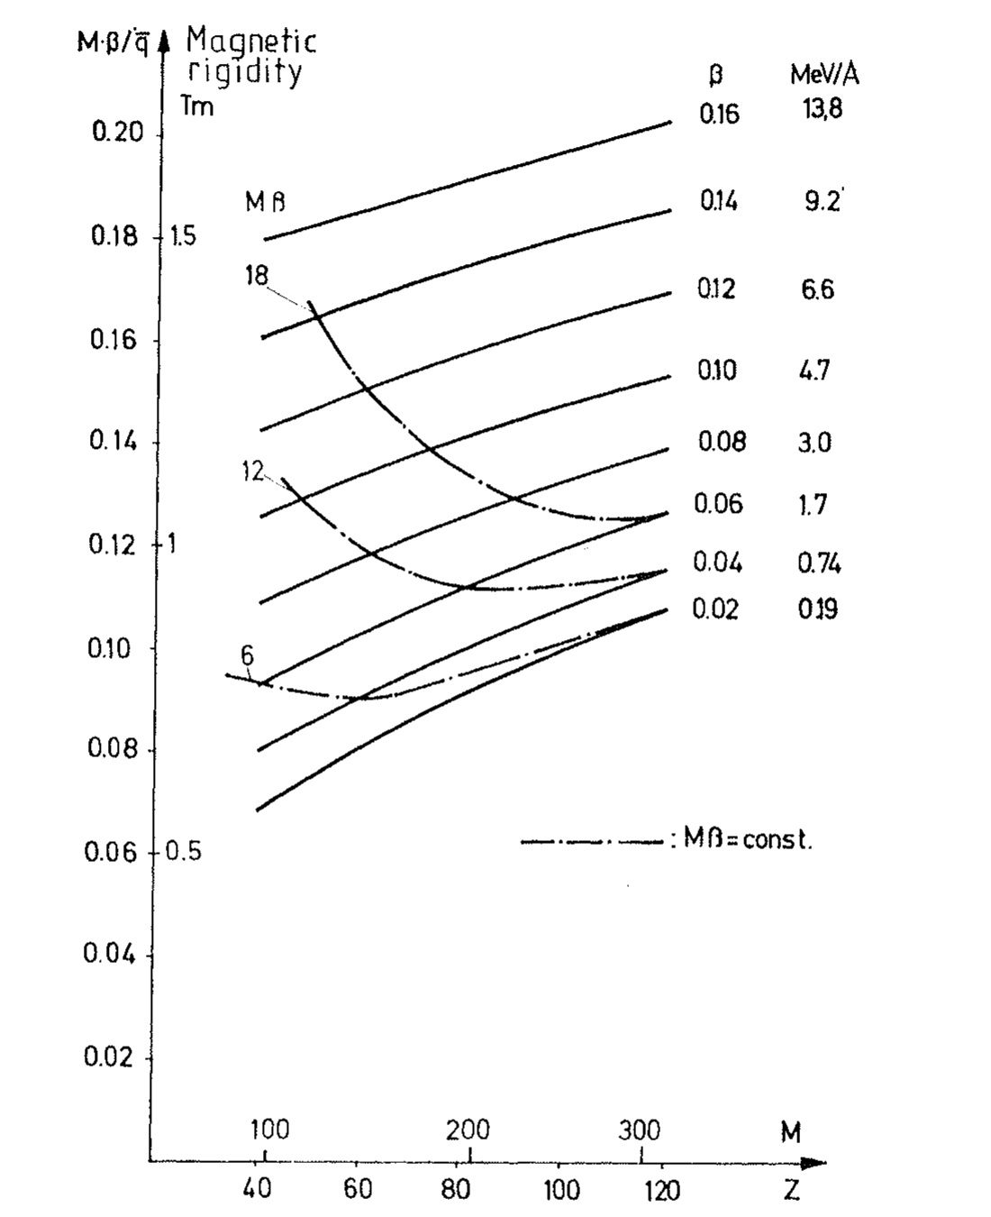

Residues share the beam’s momentum but not its speed, so a magnet fails.
Comment: The formula here doesn’t match our
paradigm. Make it.
Learning Group
Content 1 / 10
Notes:
Recall how a mass spectrometer works: a magnet bends each ion by momentum over charge. Here is the catch. In complete fusion, the compound nucleus takes the full projectile momentum, so to a magnet the residue looks almost like the beam — the book shows their magnetic rigidities nearly coincide (Fig. 9). But that momentum now sits on a much heavier nucleus, so it moves at the centre-of-mass velocity: for iron on lead, about a fifth of the beam speed. Same momentum, lower speed — that is our handle.

Slide 6
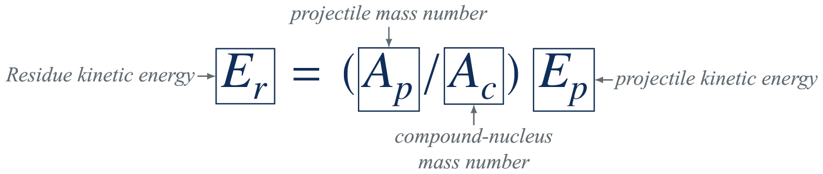
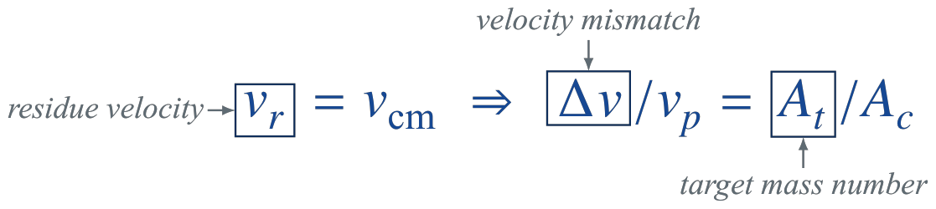
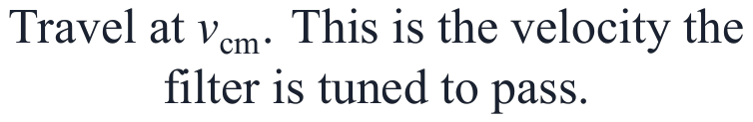

Residues share the beam’s momentum but not its speed, so a magnet fails.
1. Residue = heavy remnant of the compound nucleus after it evaporates a few light particles.
2. Er = (A_{p}/A_{c}) E_{p} — the residue’s kinetic energy under full momentum transfer: motion at v_{cm}, slower than the beam.
3. A_{t} — ²⁰⁸Pb: 208.
4. v_{cm} = (A_{p}/A_{c}) v_{p}, so Δv/v_{p} = 1 − A_{p}/A_{c} = A_{t}/A_{c}: the heavier the target, the slower the residue (⁵⁸Fe + ²⁰⁸Pb: Δv/v_{p} = 208/266 ≈ 0.78).
vᵣ
vₚ
Δv
Fusion residues
Unreacted beam
Other channels
Transfer stays near beam or target velocity; fission-after-fusion spreads over a wide lab-velocity range.
Learning Group
Content 1 / 10
Notes:
Recall how a mass spectrometer works: a magnet bends each ion by momentum over charge. Here is the catch. In complete fusion, the compound nucleus takes the full projectile momentum, so to a magnet the residue looks almost like the beam — the book shows their magnetic rigidities nearly coincide (Fig. 9). But that momentum now sits on a much heavier nucleus, so it moves at the centre-of-mass velocity: for iron on lead, about a fifth of the beam speed. Same momentum, lower speed — that is our handle.

Slide 7
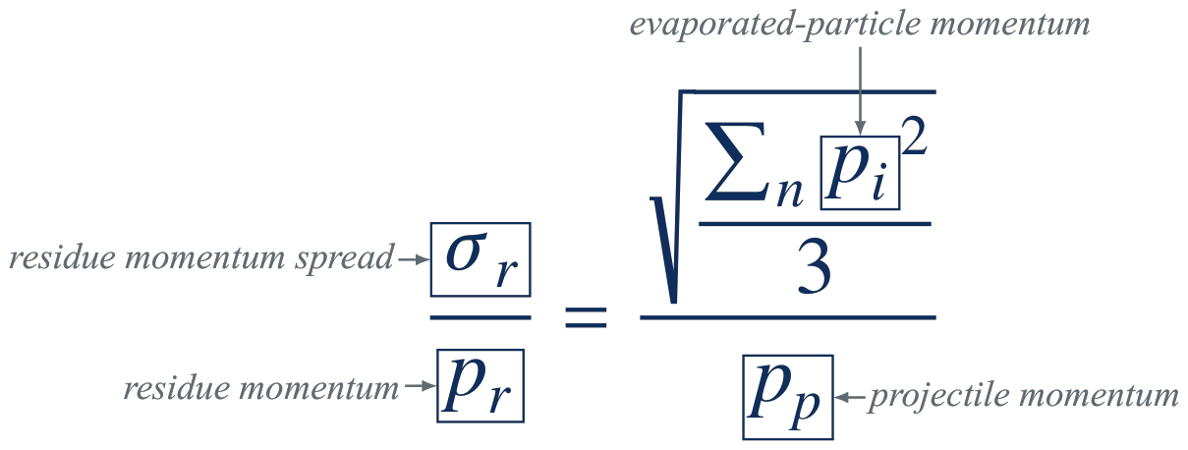




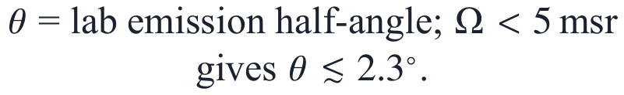
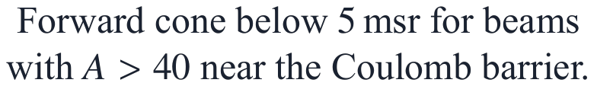
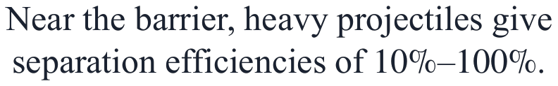
Evaporation residues are kinematically focused into a narrow forward cone.
A heavy projectile brings large forward momentum; a few evaporated particles barely deflect the residue.
Evaporation = how the hot compound nucleus cools: it emits a few light particles (n, p, α).
Random kicks — each emission recoils the residue in a random direction; the kicks add in quadrature and split equally over x, y and z, so dividing by 3 keeps one axis.(Comment: I think this phrasing is pretty awkward. Have you ever thought about it?)
Narrow cone
Small solid angle
High transmission
Learning Group
Content 2 / 10
Notes:
Evaporation is how the hot compound nucleus cools down: it boils off a few neutrons, protons or alphas. Each one kicks the residue in a random direction. Random kicks add in quadrature, and the 3 keeps the part along one axis. Compare that with the projectile momentum in the denominator: a heavy beam makes it large, so the residues stay in a narrow forward cone.

Slide 8
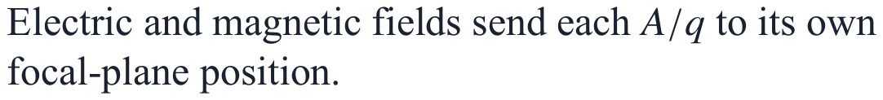
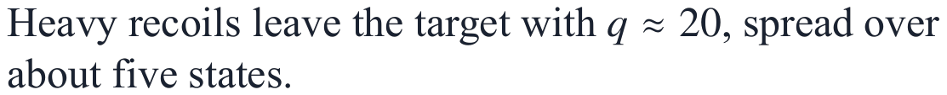
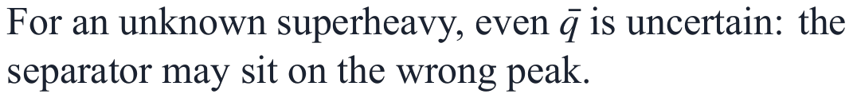

Mass separators lose most of the yield to charge-state splitting.
Sorts by mass-over-charge
kept
About five charge states
lost
lost
Mean charge not known in advance
lost
lost
Most of the yield is lost
18
19
20
21
22
Only one or two states reach the focal plane; the others are thrown away.
Learning Group
Content 3 / 10
Notes:
But a magnet is not the whole story: recoil mass separators add electric fields, and they do separate residues from the beam. Their catch is the charge state. They disperse by A/q, and heavy ions emerge in a spread of charge states centred near q ≈ 20 — about five states carry the intensity. A mass separator keeps only one or two, losing most of the yield. On the left, schematically: one residue species arrives in about five charge states; the separator transmits the navy one, and the grey ones are lost.

Slide 9
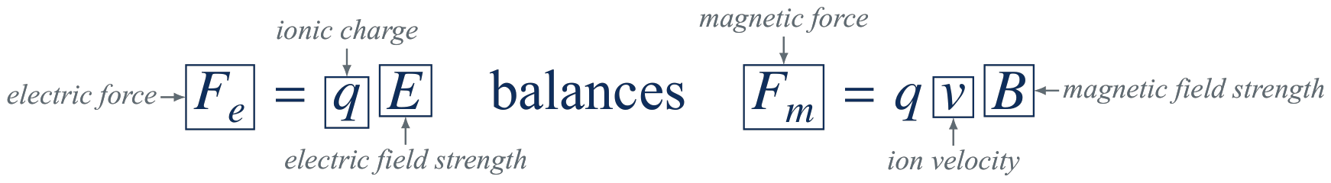
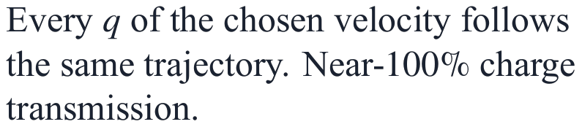
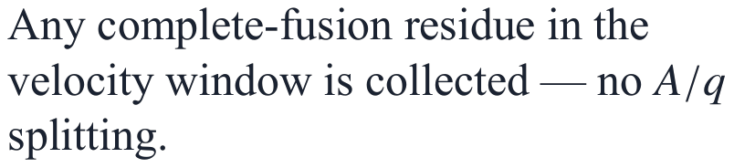
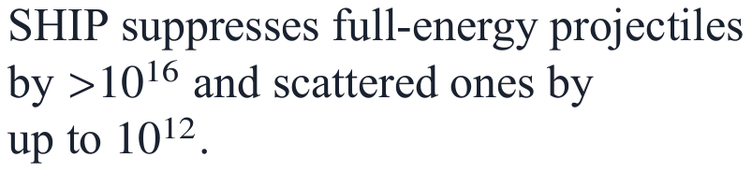
Pure velocity filters transmit all charge states and isotopes simultaneously.
All charge states
All fusion isotopes
Beam rejection
Trade-off: no mass dispersion. SHIP identifies isotopes by decay; Daresbury adds a spectrometer for mass.
Learning Group
Content 4 / 10
Notes:
Second time, same idea: same momentum, lower speed. In a pure velocity filter, the condition v = E/B does not contain the charge. All charge states of the chosen velocity pass through, giving near-100% charge-state transmission and, at SHIP, suppressing unretarded projectiles by more than 10¹⁶. E here is the electric field, not kinetic energy.

Slide 10
Outline
1. Why not just use a mass spectrometer?
2. How does a filter survive the beam?
3. Without mass, how do we know what we caught?
4. When is a velocity filter the wrong tool?
Notes:
Second of four. For element 108, about 2 × 10¹⁷ projectiles hit the target for every atom caught. How does the filter survive that beam?

Slide 11
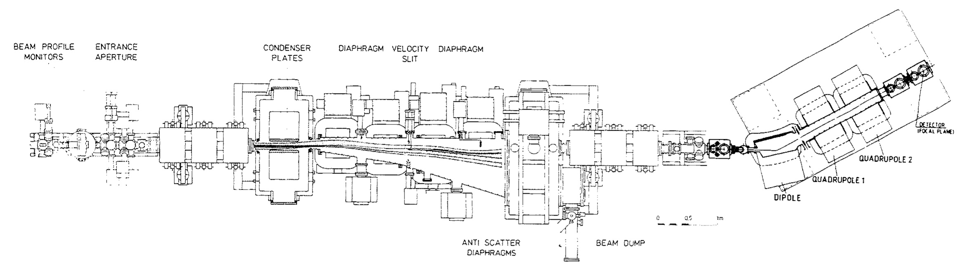
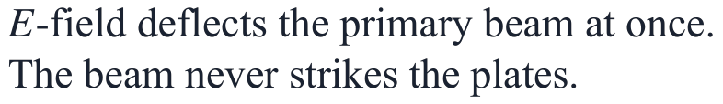
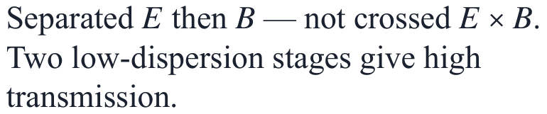
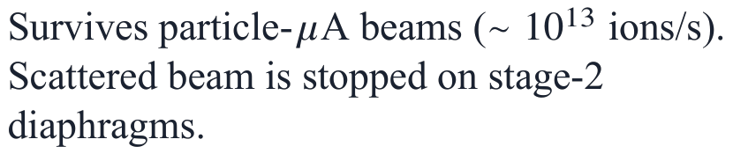
SHIP uses separated fields to protect its condenser plates.
Fig. 12 · SHIP (GSI) and the separator NASE: the plate condenser comes first; dipoles send the projectile beam to the dump.
Condenser first
Not a Wien filter
High current
Learning Group
Content 5 / 10
Notes:
This is SHIP at GSI. Notice it is not a crossed-field Wien filter. The electric condenser comes first. It deflects the primary beam away immediately, so the beam never hits the plates — no scattered background, no heat damage.

Slide 12
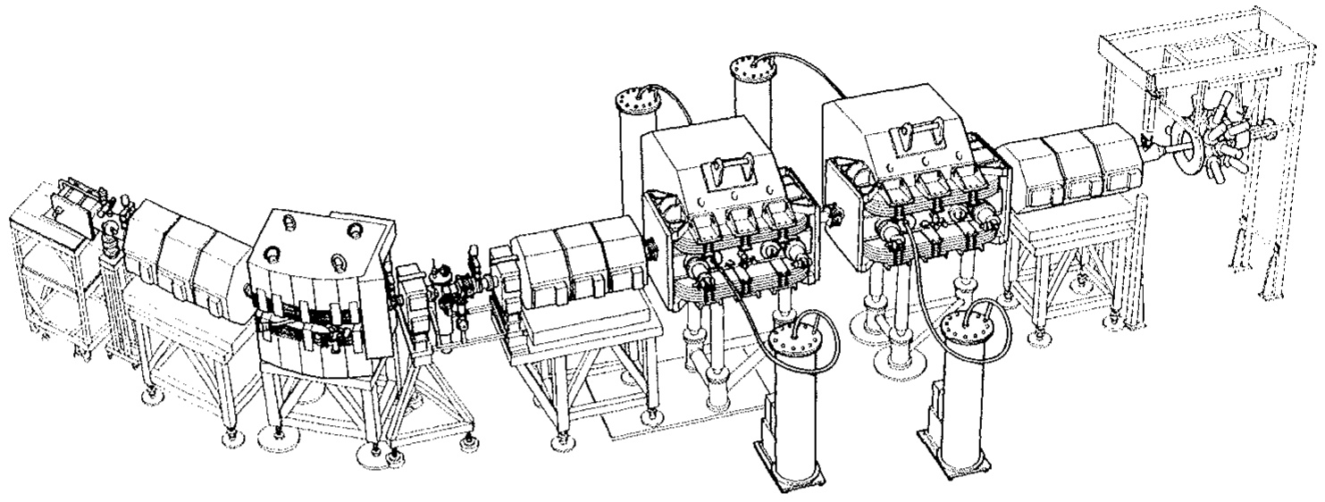


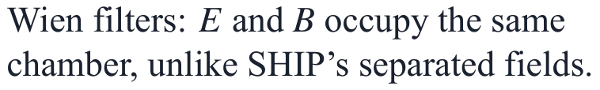
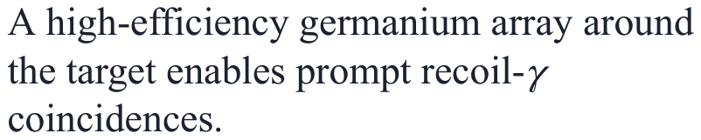
The Daresbury separator uses crossed fields and energy refocusing.
Fig. 15 · Daresbury recoil separator: two crossed-field filters followed by a DQQQ spectrometer.
DQQQ spectrometer
A magnetic spectrometer after the filters refocuses the energy spread at the focal plane.
Learning Group
Content 6 / 10
Notes:
In contrast, Daresbury uses crossed E and B fields, followed by a magnetic spectrometer to refocus the energy spread.

Slide 13
Outline
1. Why not just use a mass spectrometer?
2. How does a filter survive the beam?
3. Without mass, how do we know what we caught?
4. When is a velocity filter the wrong tool?
Notes:
Third of four. Back to the trade-off from slide 8: the filter never measures mass in flight. So how do we know what we caught?

Slide 14
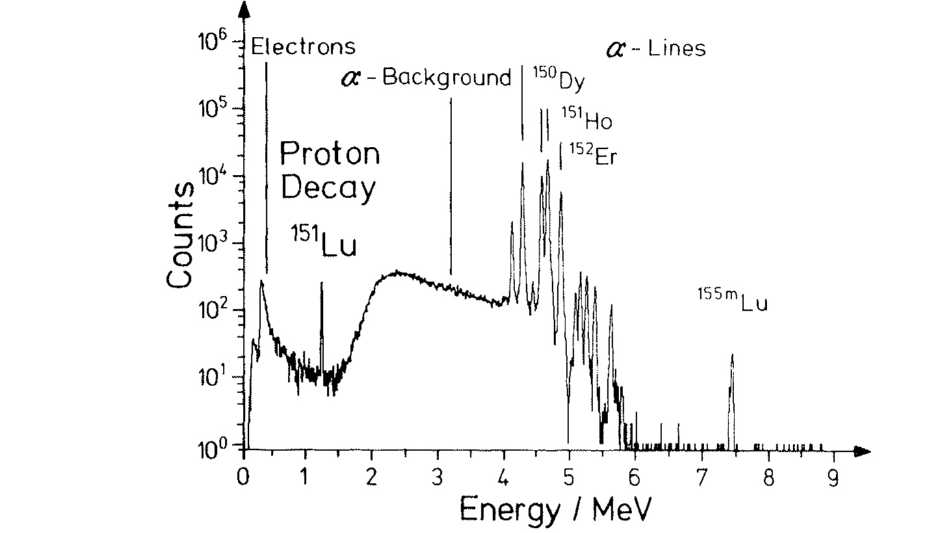


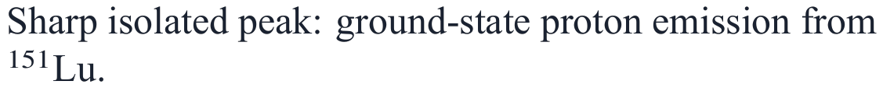
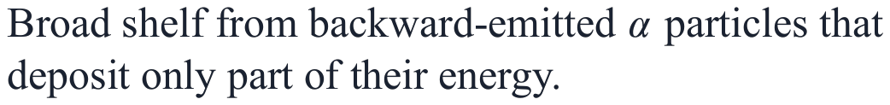

SHIP delivers short-lived residues to a Si surface-barrier detector.
Escape bump
Implant time-tag gives the half-life event by event.
Learning Group
Content 7 / 10
Notes:
Because SHIP separates in under 2 microseconds, we can implant short-lived residues into silicon. Here is the first ground-state proton decay from Lutetium-151, cleanly isolated from the alpha background.

Slide 15
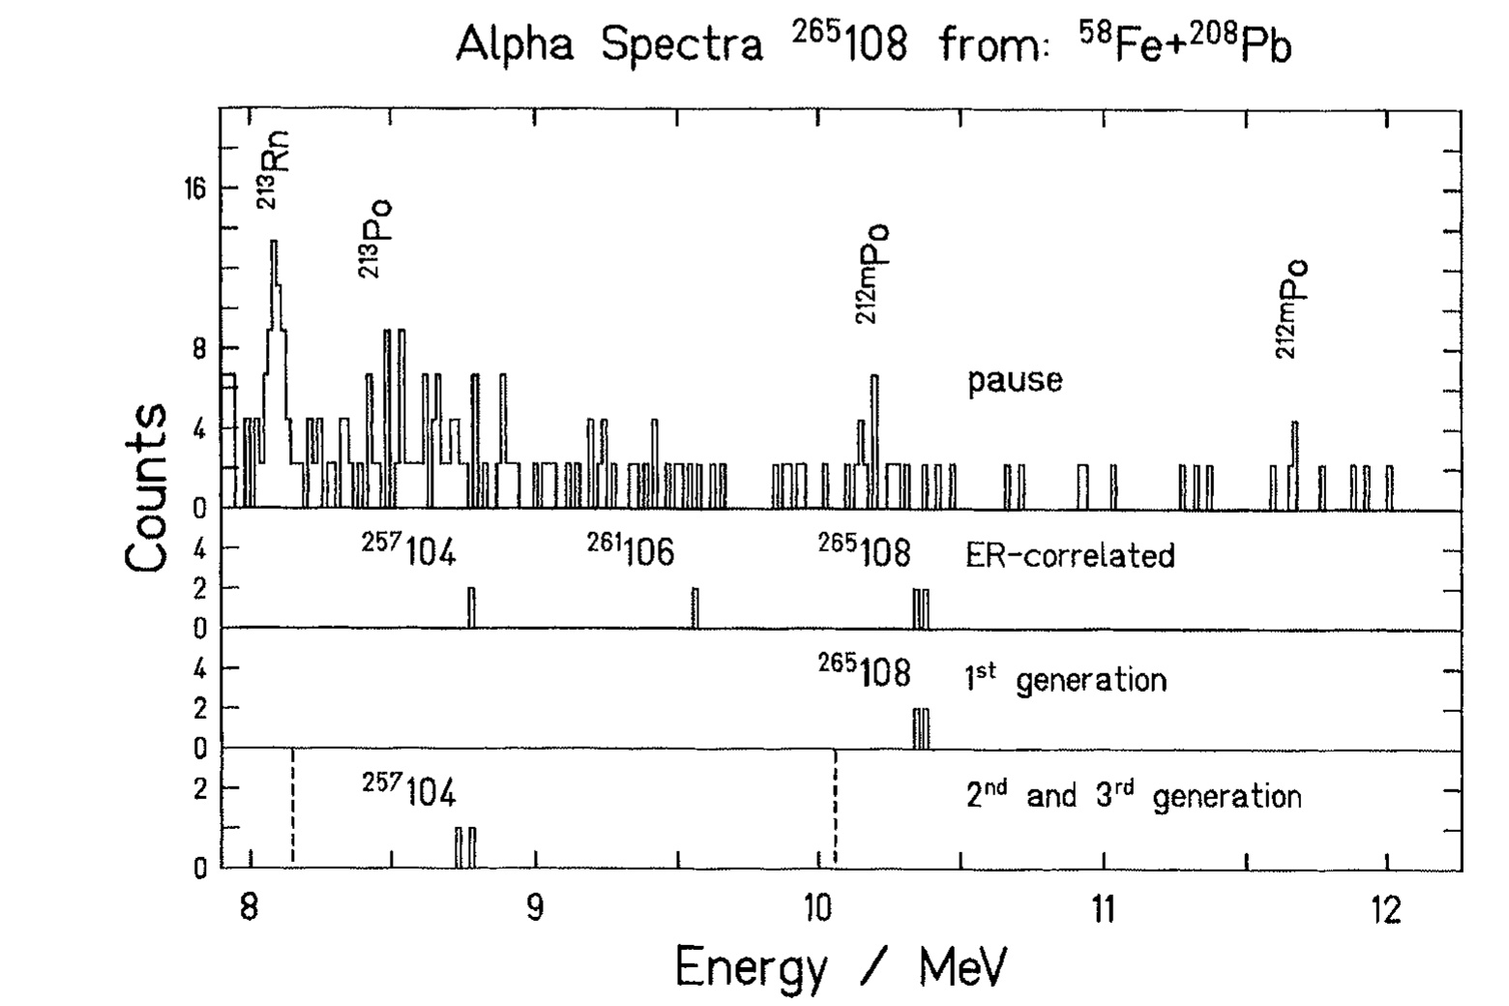
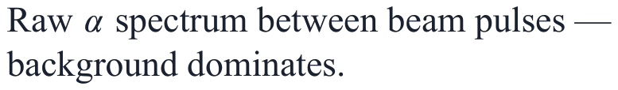
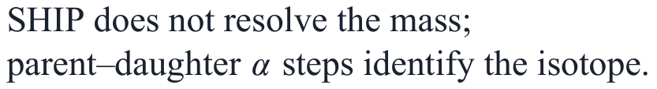
Genetic decay-chain tagging identified element 108 from just three atoms.
1 Ungated
2 Implant-correlated
Decay must follow an implant in time and position; 2 of the 3 atoms remain.
3 Heavy-mass window
A TOF + implant-energy window keeps only heavy recoils (‘1st generation’ panel).
4 Daughter generations
Learning Group
Content 8 / 10
Notes:
Back to the three atoms from the start. Out of 6 × 10¹⁷ projectiles over ten days, SHIP produced just three atoms of element 108. Because SHIP does not measure mass, we prove the isotope by watching it alpha-decay step by step into known daughters.

Slide 16
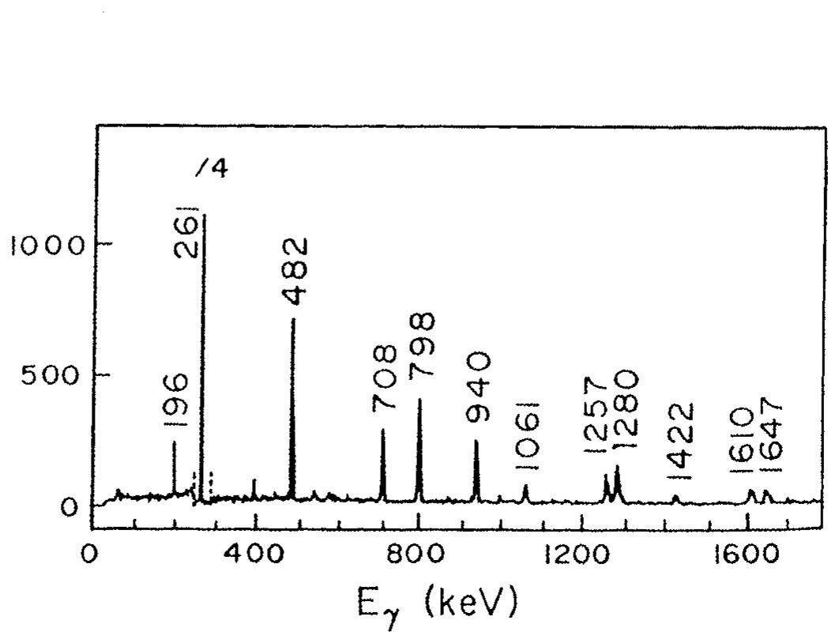
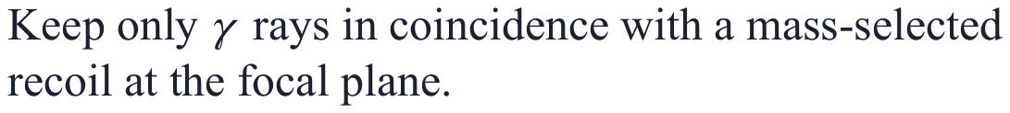
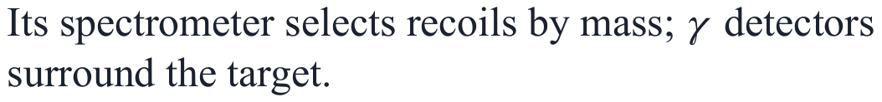
Recoil-gamma tagging reveals high-spin states of the mirror nucleus ⁴⁹Mn.
Tag at the focal plane
Background suppressed
Coulomb excitation and target impurities drop out of the spectrum.
Mirror nucleus
Why Daresbury
Learning Group
Content 9 / 10
Notes:
At Daresbury, they surround the target with gamma detectors. By only looking at gammas coincident with a mass-selected recoil at the focal plane, the Coulomb-excitation and target-impurity background disappears.

Slide 17
Outline
1. Why not just use a mass spectrometer?
2. How does a filter survive the beam?
3. Without mass, how do we know what we caught?
4. When is a velocity filter the wrong tool?
Notes:
Last of four: when is a velocity filter the wrong tool?

Slide 18
Velocity filters are the most sensitive separators for low-energy fusion.
Device
Use when
Not ideal when
Velocity filter
Coulomb-barrier fusion; highest transmission
Mass must be resolved in flight
RMS / FMA
RF separator
Pulsed beams; TOF phase
Gas-filled
Very asymmetric reactions; actinide targets; high efficiency
Scattering; no velocity resolution
Fragment separator
Wrong energy regime; degraders destroy slow beams
Learning Group
Content 10 / 10
Notes:
Velocity filters are the best choice for Coulomb-barrier fusion where you need maximum transmission. If you need mass resolution in flight, use an RMS. If you have relativistic energies, use a fragment separator.

Slide 19
Contributions
Velocity-based separation yields zero charge dispersion.
1
All charge states pass together, so cross sections below 10 pb become detectable.
Separated-field design keeps the beam off the condenser plates.
2
Condenser-first SHIP deflects the primary beam before it can hit the plates.
Decay tagging identifies single atoms.
3
Learning Group · Zhiheng Hu · 29 Sep 2026
Notes:
To summarize: velocity filters ignore mass to achieve 100% charge-state transmission; SHIP's separated fields survive particle-microampere beams; and this extreme sensitivity makes single-atom discoveries possible.

